Slide 1
See the hop. Stop the wrong one.
Prove what happened.
Agent
Cursor · Claude Code · MCP
PyxGrant
A self-hosted control plane for AI agents. A grant can only narrow. Each hop is allowed, redacted, held, or refused — then signed.
allow · redact · hold · refuse
Sink
Kernel 2.1203.0 · One Go binary · Signed receipts · Sacramento
tools · models · rails · peers
pyxgrant.com · kernel 2.1203.0
01 / 12
Notes:
COVER. Say routed hops only. Do not say we see every action on the laptop.

Slide 2

THE PROBLEM
Agents act with real credentials. Nobody watches.
Tool poisoning
Confused deputy
Runaway agency
A tool definition changes after approval. Hidden parameters harvest context. Teammates run the new version with no second prompt.
Untrusted content walks the session to an irreversible or egress sink. Byte-matching misses the carrier.
Destructive calls, budget burn, and sub-agents — with no signed person in the loop.
1 in 5
~700
7.2
breaches involved shadow AI
orgs reached via stolen agent tokens
CVSS — approved MCP tool silently swapped
IBM Cost of a Data Breach, 2025
Salesloft Drift, August 2025
CVE-2025-54136
pyxgrant.com · kernel 2.1203.0
02 / 12
Notes:
PROBLEM. Keep the three citations exact. This is already happening.

Slide 3
WHY NOW
California named this. The category is already priced.
THE STATE
THE MARKET
THE INCIDENT
EO N-9-26
Four acquisitions
CVE-2025-54136
Signed 18 September 2026. The recitals describe AI agents working independently to defeat security protocols — in some cases undetected for months.
Protect AI → Palo Alto. Lakera → Check Point. Prompt Security → SentinelOne. CalypsoAI → F5. The category is funded. Who can prove it is still open.
An approved tool config was swapped after approval. Teammates ran it with no second prompt. CVSS 7.2.
EU AI Act Art. 12 logging for Annex III high-risk systems: 2 December 2027. Bought in the 2027 budget cycle.
pyxgrant.com · kernel 2.1203.0
03 / 12
Notes:
WHY NOW. Do not say 2 Aug 2026. Recheck acquisition dollar amounts before a meeting — names only on this slide.

Slide 4
THE IDEA
Sit on the hop. Decide. Sign.
Agent
PyxGrant
Sink
Cursor · Claude Code · MCP
allow · redact · hold · refuse
tools · models · rails · peers
Allow
Redact
Hold
Refuse
Recorded as-is
Secrets and PII stripped
Waits for a signed person
The agent sees the error
Grant
Freeze
Revoke
Can only narrow. Never widen.
Holds tool, model, A2A, and AG-UI — including in-flight legs.
Ends every child and every bound session. Silence means no.
Inline on the path it is given. A call that never reaches PyxGrant is named later — not stopped.
pyxgrant.com · kernel 2.1203.0
04 / 12
Notes:
PRODUCT. Four verbs + grant/freeze/revoke. Do not claim we wrap the whole laptop by default.

Slide 5
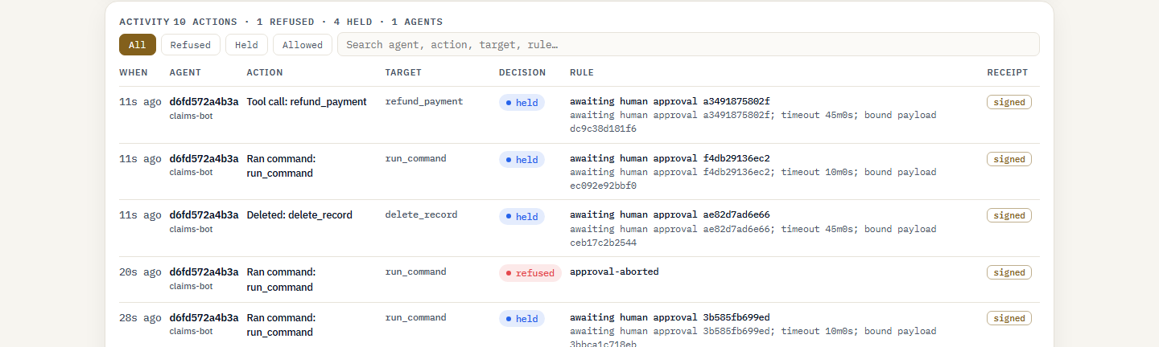
PROOF
An incident, start to finish.
1 Spot
A refused call: rule, reason, signed receipt.
2 Scope
Which grant, which planes, which bound sessions.
3 Contain
Freeze holds every plane. Resume is reversible. Revoke is not.
4 Prove
The refuse lands in the hash-chained log. Open Prove and flip a field.
Product capture — not a customer tenant.
pyxgrant.com · kernel 2.1203.0
05 / 12
Notes:
PROOF. Screenshot is ours. Freeze is not a host wipe. Kill residue is probed vs UNVERIFIABLE.

Slide 6
MARKET
The buyer already has to show it. The category is already priced.
Beachhead
Buyer
Category
Coding agents on the laptop — Cursor, Claude Code, MCP — in health, higher ed, state and local, regulated mid-market.
CISO and platform security, with internal audit. They cannot assert that an agent behaved. They have to prove it.
Four acquisitions in a year: Protect AI → Palo Alto, Lakera → Check Point, Prompt Security → SentinelOne, CalypsoAI → F5.
What we will not put on this slide
No TAM we did not buy. No ACV we have not closed. EU AI Act Art. 12 logging for Annex III is 2 December 2027 — it gets bought in the 2027 budget cycle. California EO N-9-26 already named the threat.
pyxgrant.com · kernel 2.1203.0
06 / 12
Notes:
MARKET. Recheck acquisition dollar amounts before quoting them. Do not invent TAM.

Slide 7
WHERE WE SIT
Three jobs. We do one of them.
Zenity · Prisma · Straiker
Lakera · Prompt Security
The hop
Discovery
Prompt filters
PyxGrant
They find agents across the company.
They score the prompt for injection.
We decide the call before it lands.
They do not sit on the hop.
They do not sign a grant or a receipt.
Grant can only narrow. Receipt you can check.
They lead at finding agents and at catching novel injection. We lead at stopping the action and proving it. That is the split. We are not trying to be all three.
pyxgrant.com · kernel 2.1203.0
07 / 12
Notes:
COMPETITION. Three jobs, not a matrix. Concede discovery and injection recall in the footer line. Do not say unique.

Slide 8
WHAT SHIPPED
One binary. The controls that matter, together.
MCP + hooks
Model plane
A2A / AG-UI
DLP on the hop
stdio/HTTP proxy. Claude Code, Cursor. Laptop hook installs hardened.
Meter, budget, redact, and hold listed models.
Holds and refuses, including in-flight legs.
Secrets and PII redacted before the model.
Narrow-only grants
Freeze / revoke
Pin / rug-pull
Evidence pack
Re-delegate without a shared secret. Never widen.
Freeze every plane. Revoke ends the tree.
A changed tool description is quarantined.
Signed. Prove flips a field without us.
pyxgrant.com · kernel 2.1203.0
08 / 12
Notes:
SHIPPED. Only what is in the binary. Do not add host minifilter, FIPS, FedRAMP, or hosted SaaS.

Slide 9
WHO PAYS
Priced per protected estate. First proof is free.
Evidence Pilot
Estate license
Air-gapped
30 days. One team. Observe only.
They keep the signed pack.
One business unit, then the estate.
Freeze and revoke live.
Self-hosted. No telemetry.
Offline verify.
Nothing
Annual, per estate
Premium
Buyer
Why self-hosted
CISO and platform security, with internal audit. Health, higher education, state and local, regulated mid-market — buyers who have to show it, not assert it.
Prompts, files, and decisions stay on the estate. Often the difference between a procurement and a polite no.
pyxgrant.com · kernel 2.1203.0
09 / 12
Notes:
BUSINESS. No list price. Do not invent ACV. Evidence Pilot matches the site: 30 days, observe only.

Slide 10
TRACTION
Product is shipping. Revenue is not.
Kernel 2.1203.0
Customers
One static Go binary. Console, freeze, revoke, signed receipts.
Zero paid. Zero named pilots. Do not round this up.
Prove
Pipeline
An outsider flips a field without us. Fail-closed on the hop we are given.
No committed pipeline on this slide.
Site
Not yet
pyxgrant.com. Evidence Pilot is live as the first motion.
Console HA, FIPS, FedRAMP. Kernel cage is Linux-only. Host wrap is not the product.
pyxgrant.com · kernel 2.1203.0
10 / 12
Notes:
TRACTION. Pre-revenue is a fact. Product evidence is not demand evidence.

Slide 11
TEAM
One founder. The kernel is shipped. The company is not.
Founder
Open seats
Sirisha Gottipati
First enterprise hire
Founder, Omantiv. Built and ships PyxGrant. Sacramento.
A CISO-facing seller. Not hired.
First GTM
One Evidence Pilot closed. Not hired.
Add prior roles here when you want them on the slide.
Advisors
None named on this deck.
pyxgrant.com · kernel 2.1203.0
11 / 12
Notes:
TEAM. Do not invent a bio, a co-founder, or advisors.

Slide 12
THE ASK
Two asks. One we can take today.
THIS WEEK
CAPITAL
A 30-day Evidence Pilot.
Observe only.
Raise, instrument, use of funds.
One team’s coding agents. Nothing is refused in observe mode. They leave with a signed pack. Enforcement is a second step.
Not on this slide until you set them. A round with a blank number is worse than a pilot with a date. Fill amount, instrument, and three uses — first estate, first seller, SOC 2 — before this file leaves the laptop.
Install → hold → prove.
pyxgrant.com
Sirisha Gottipati · Founder · Sacramento · pyxgrant.com
pyxgrant.com · kernel 2.1203.0
12 / 12
Notes:
ASK. Left is live. Right stays blank until the founder types a real raise.

